Slide 1
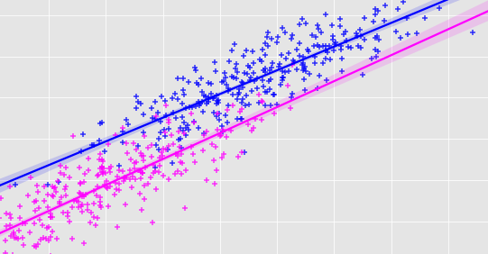
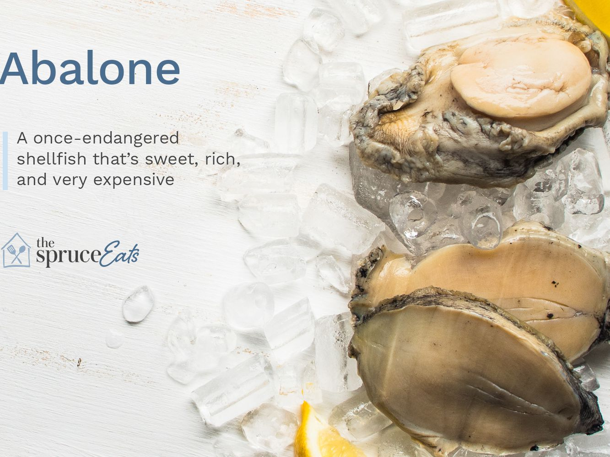
AGE PREDICTION OF ABALONE
GROUP 15
BOJJA CHARITHA REDDY - EE19BTECH11001
MARPU MYTHRI VARSHITHA -EE19BTECH11014
BANOTHU SANA -EE19BTECH11021
LAKKU NALINI AISHWARYA -EE19BTECH11033
JALADURGAM ESHWARI -EE19BTECH11042
KALAPAGOOR MAHIMA -MA19BTECH11006

Slide 2
PROBLEM STATEMENT
ABALONE - A Marine Snail, a Rare and Expensive Species.
Endangered in state, Scientists are trying to increase the population count of this Species.
Age Prediction will be highly useful in experimental Studies.
Cutting the shell through the cone, dyeing it, and counting the number of rings via a microscope are used to assess the age of abalone- A general time consuming process.
THE SOLUTION !!! A Rather simple way to predict age by obtaining a model to predict the age of abalone from physical measurements .

Slide 3

Please click on this to watch the video

Slide 4
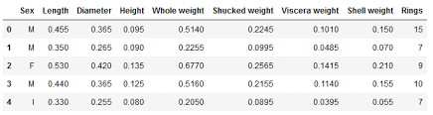
EXPLAINED!!
The Physical Measurements of Abalone will predict the no. of rings(Dependent variable). Age of abalone can be determined from the number of it’s rings.
Fitting the parameters into a multiple regression model solves the problem. Optimizing the model by performing tests is our target.
The DataSet:- https://www.dcc.fc.up.pt/~ltorgo/Regression/abalone.tar.gz

Slide 5
PROJECT HIGHLIGHTS
ADDITIVE MODEL
ADDITIVE MODEL REMOVING FEW PARAMETERS
AIC SELECTED MODEL
NUMBER OF VARIABLES VS AIC VALUES
THE DATA
Sex is the categorical variable(M,F,Infant)
Length,Diameter,Height, Whole Weight,Shucked Weight,Viscera Weight,Shell Weight,Rings are all numerical variables.
The dataset includes the dependent variable Rings. Rings + 1.5 approximately gives the age of an abalone.
ADDITIVE LOG MODEL
ADDITIVE LOG MODEL WITH AUTOCORRELATION CORRECTION

Slide 6
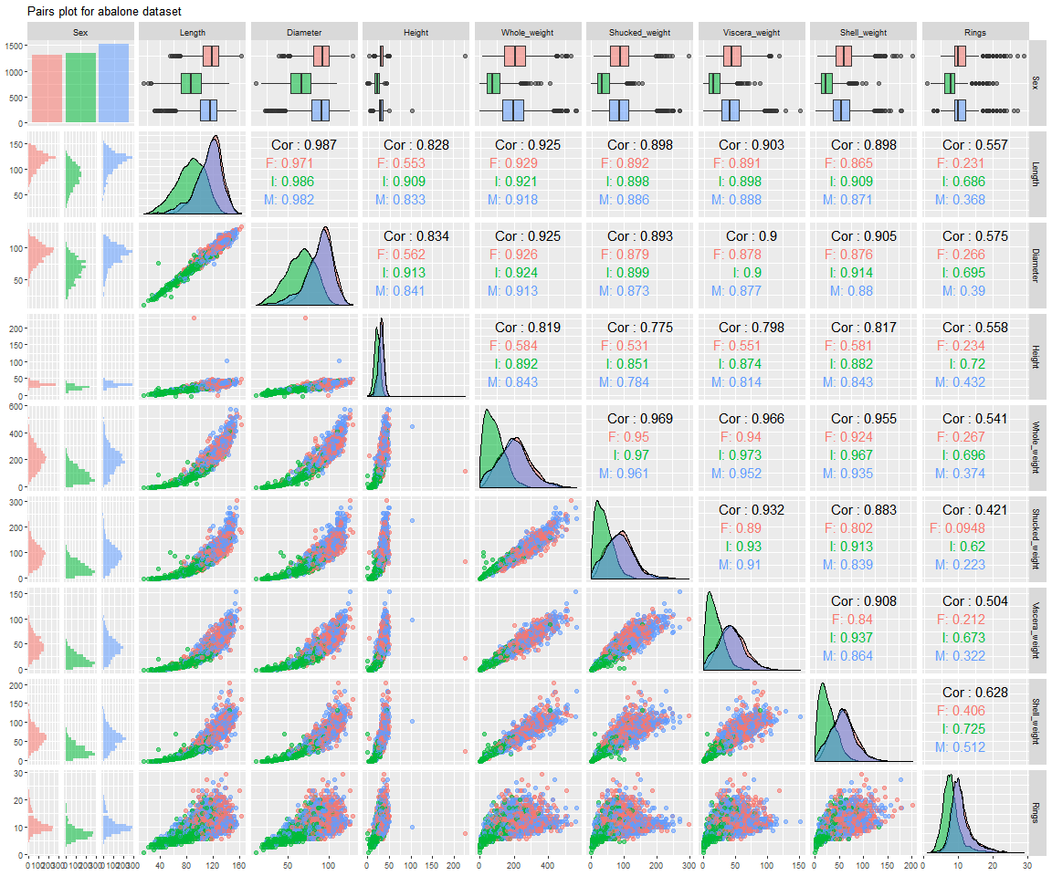
PAIR PLOTS
Building a great scatter-plot matrix
ggpairs(abalone, aes(colour = Sex, alpha = 0.8), title="Pairs plot for abalone dataset") +
theme_grey(base_size = 8)

Slide 7
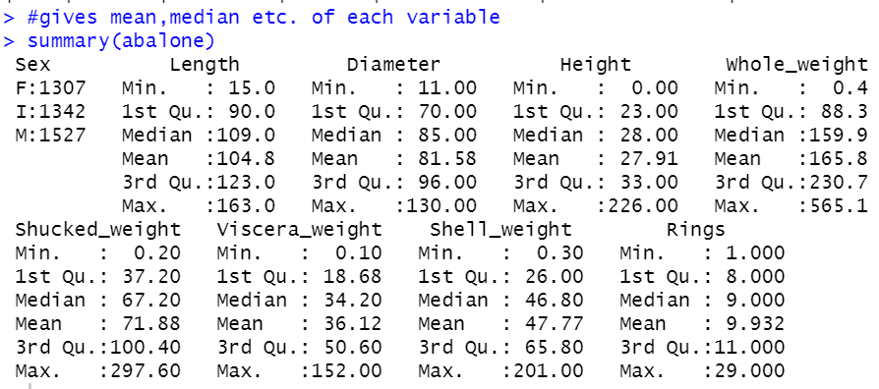
Observations from the pair plot:
From pair plots, we observe that there is high multicollinearity between the predictors. The correlation between Diameter and Length is extremely high (98.7).
Whole_weight = Shucked_weight+ Viscera_weight +Shell_weight.
Whole_weight have high correlation with other weight predictors
Abalones rings are between 5 and 15 mostly.
We use gg pairs to see the scatter plots, covariance, and box plots -everything in one big matrix.
From the plots, we see that plots for male and female are almost the same for every variable. Thus we categorize the abalones into two types-infant (I) and non-infant(NI). And then add it as a new variable.
Calculating Statistical parameters : to achieve basic understanding.

Slide 8
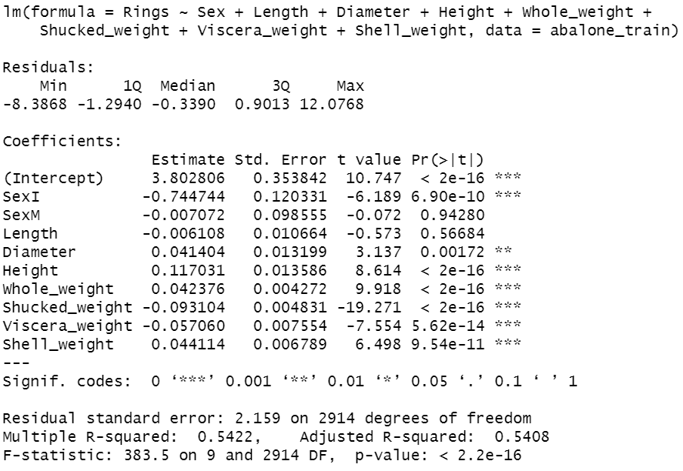
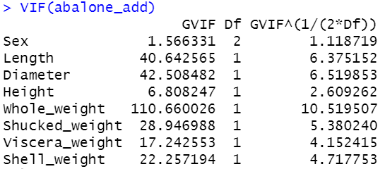
ADDITIVE MODEL
(abalone_add)
We use a simple additive model involving all the variables.
After fitting the additive model with all predictors we can see that test statistics showing all variables as significant except ‘Length’.
We see the summary of this model and calculate VIF for this model (shows high values of VIF especially for Whole_weight and diameter, this means multicollinearity is high).

Slide 9
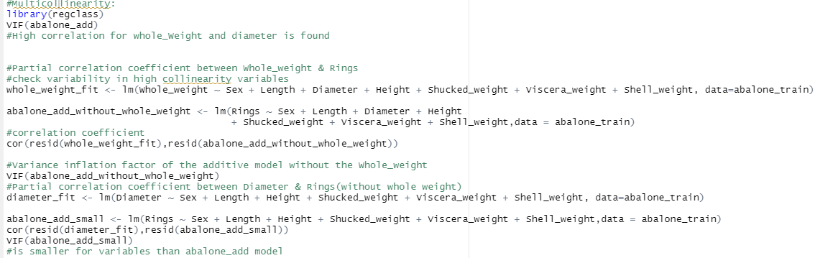
MULTICOLLINEARITY ISSUE ? , TRY TO REMOVE PARAMETERS BY CHECKING VIF

Slide 10
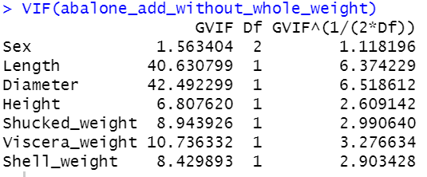
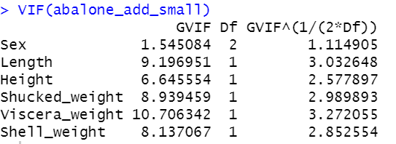
Observations:- Additive Model removing parameters
We see that covariance between the model without whole_weight and whole_weight is negligible. So, remove whole_weight from the model. (Corr: 0.1807136)
Similarly, we remove diameter too from the set of predictor variables.(Corr:0.06057918)
We run VIF on the abalone_add_small model. We can observe that the values reduce greatly after removing the two variables.

Slide 11
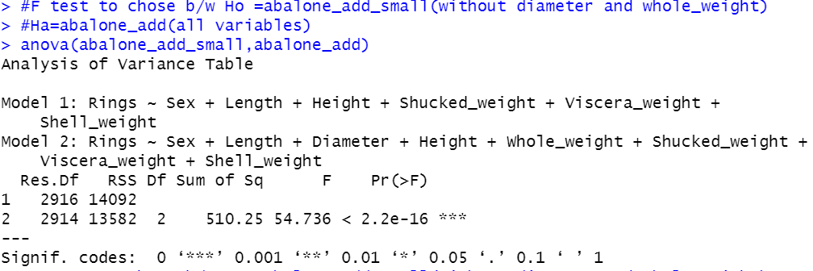
F-test:
We run an F test where the null hypothesis is that abalone_add_small is the better one, and the alternative hypothesis selects the simple abalone_add.
The F-test rejects the null hypothesis. So, we reject abalone_add_small and run AIC on abalone_add to select the best model.

Slide 12
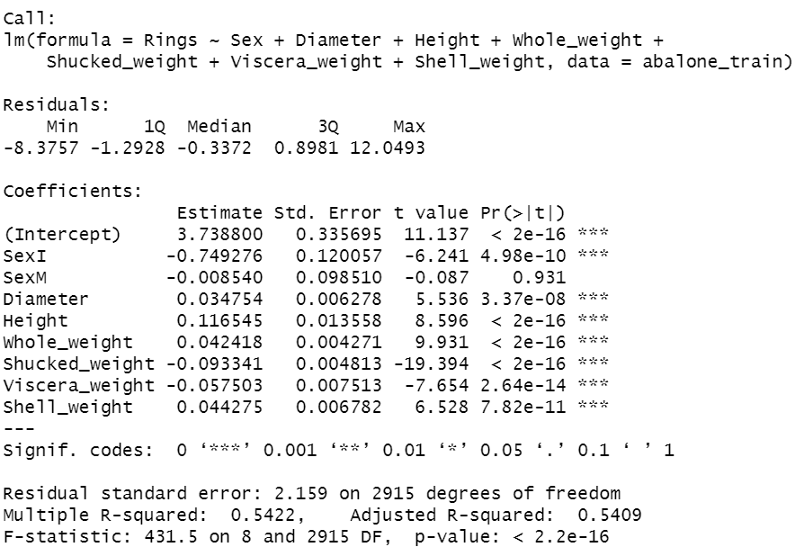
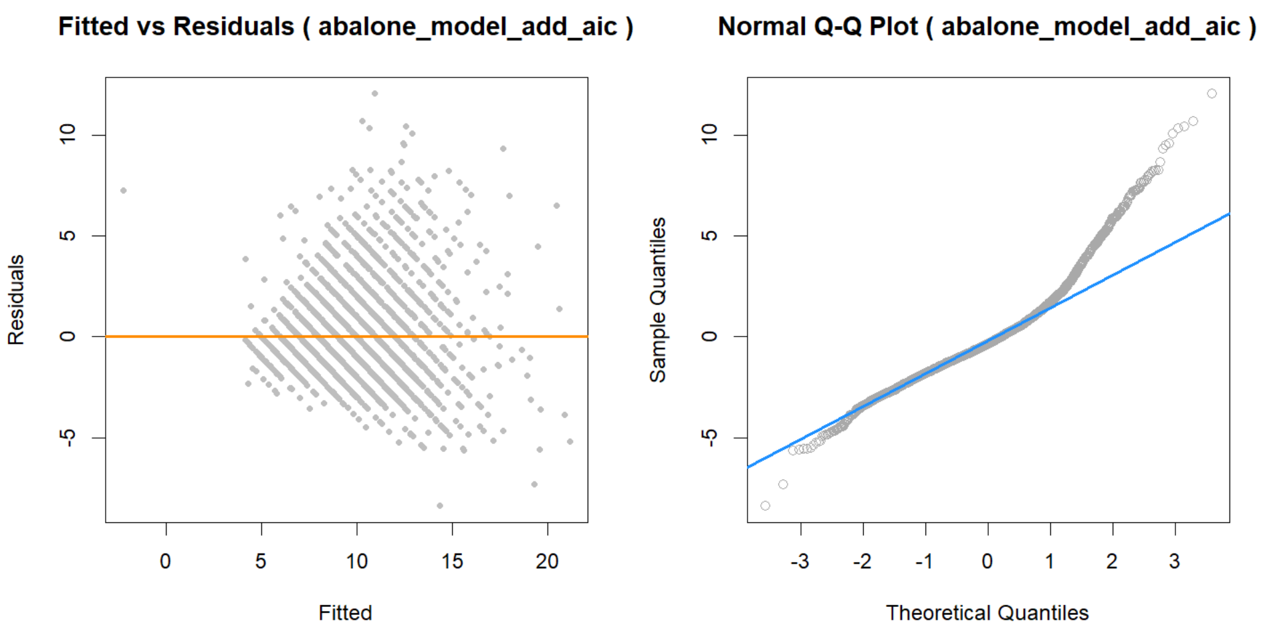
AIC SELECTED MODEL
AIC selects the model without the length predictor.
We plot the residuals and the qq-plot obtained through this AIC model. We observe that the residuals show a fan-out effect. The qq-plot also deviates from the normal line–especially the head.

Slide 13
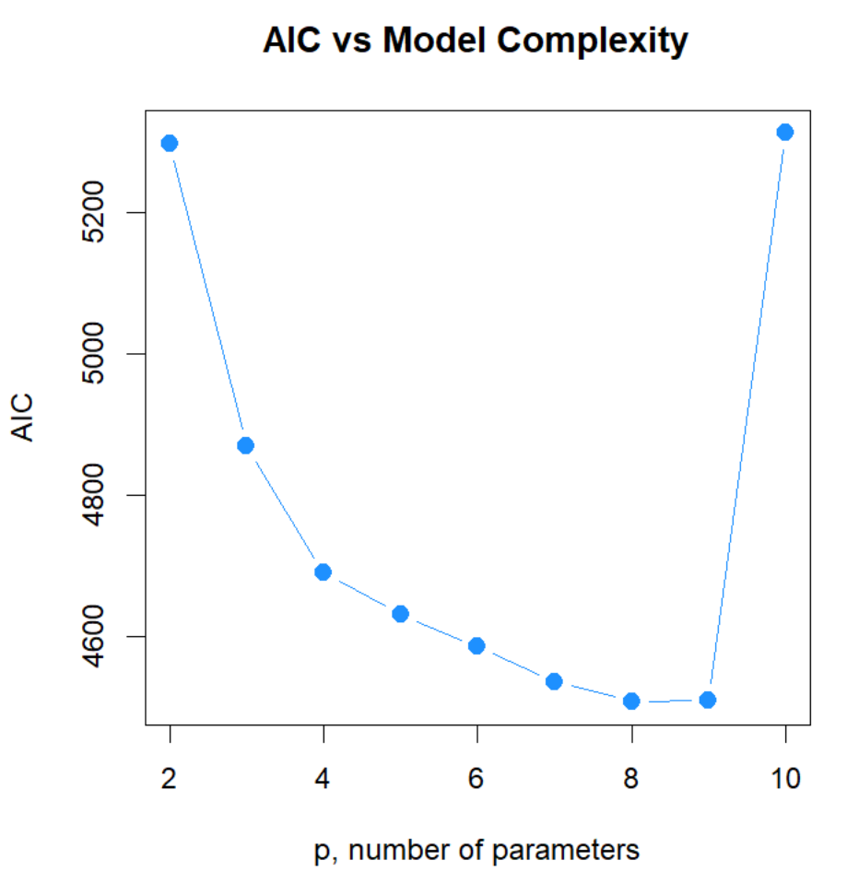
NUMBER OF VARIABLES VS. AIC VALUES
We get the summary of RSS(residual sum of squares) and adjusted R^2 of the best models of all sizes.
We calculate AIC values for each model and plot AIC vs the number of variables in the model.
Interestingly, we observe that the AIC value is the lowest when the number of predictor variables is 8.

Slide 14
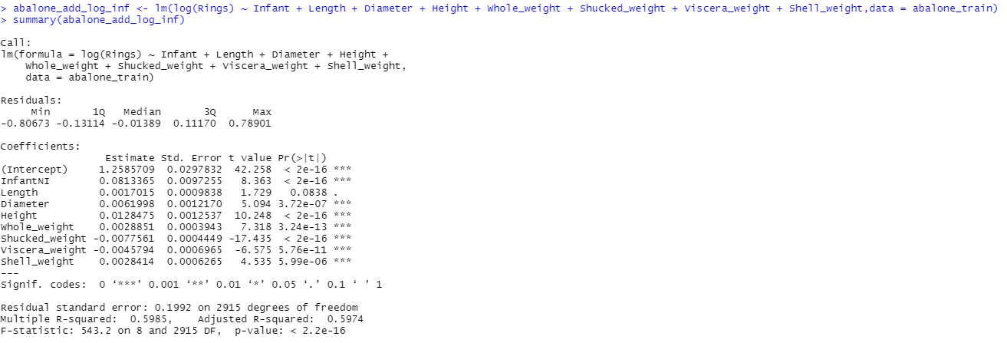
ADDITIVE LOG MODEL and its coefficients:

Slide 15
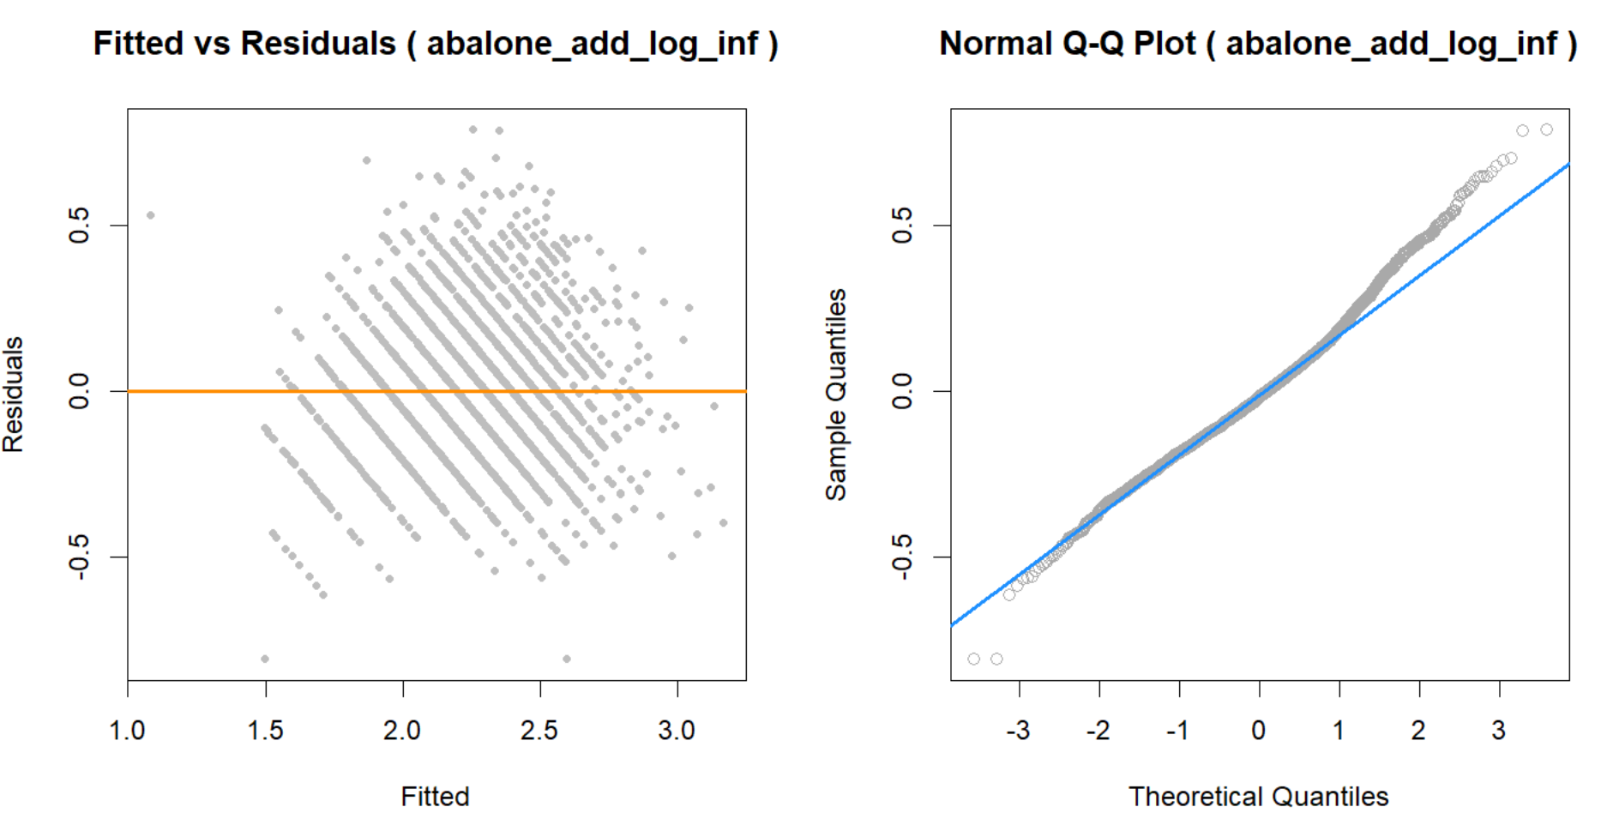
ADDITIVE LOG MODEL
(abalone_add_log_inf)
The analysis with Infant - I and NI (2 categorical variables) are the same as M, F, I because M and F have almost the same effect. Therefore we replace Sex with the Infant variable in the model. Also to reduce heteroscedasticity, we use log transforming response i.e we use log(Rings). We once again plot the residuals and qq-plot. The residuals look a lot better and the qq-plot is also much closer to the line.

Slide 16
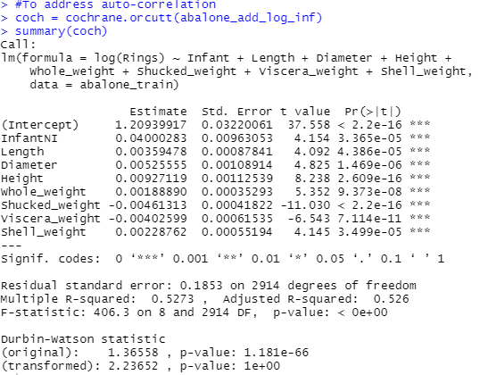
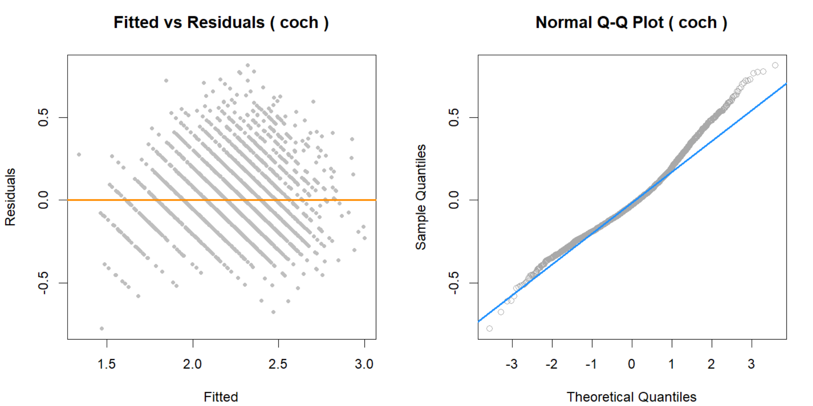
To address auto - correlation, we perform Durbin Watson test.

Slide 17
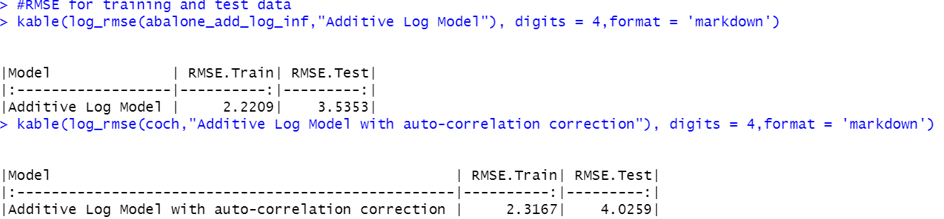

We run the Durbin-Watson test on the resultant log model. The initial Durbin-Watson factor was around 1.36. After the remedy, it’s around 2.23.
Durbin-Watson values between 1.5-2.5 are considered to be normal.
We compare the coch model and additive log model using RMSE.
By comparison, we can observe that additive log model performs better.

Slide 18
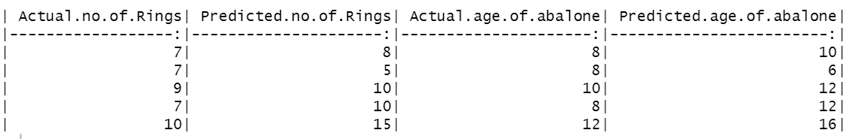
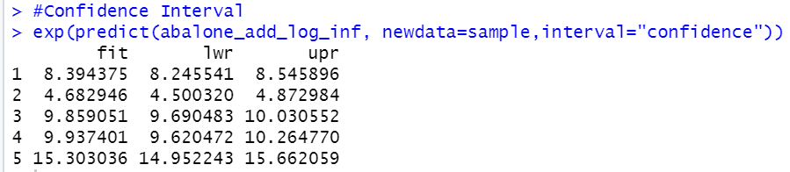
Conclusions:
The Additive Log Model is used for prediction.
We observe the confidence intervals for the first 5 predictions. The prediction intervals are in the same range. It has almost constant variance and is much closer to normal(except at the tail and at the head) as compared to other models. The additive log model has the Durbin-Watson factor around 1.36, which means the auto-correlation isn’t that much. But this model shows high multicollinearity.

Slide 19
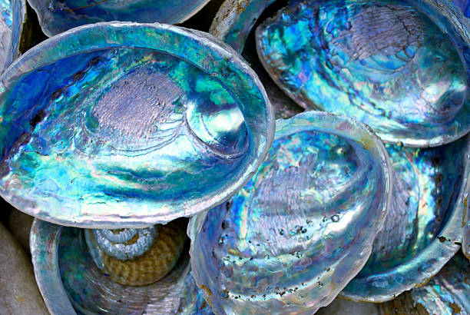
Thank you
for experiencing the journey of abalone:)

